Slide 1
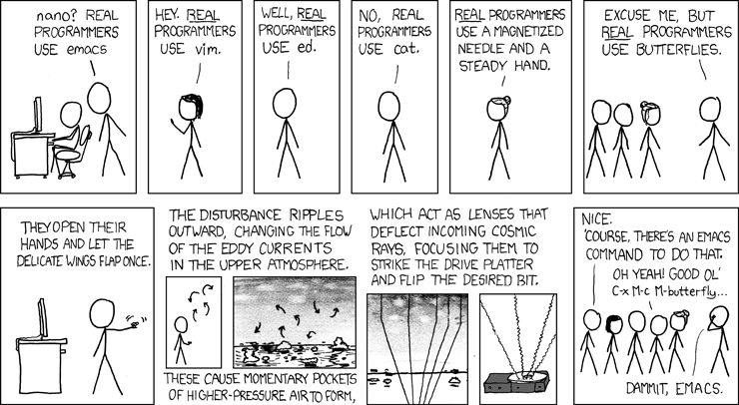

Slide 2
Publish/Subscribe Model
Publisher of A, B, C
Subscriber of A
Subscriber of A & C

Slide 3
Unix
Windows
More robust
BitTorrent
File servers
Netbooks
The implementation
ran on everything
Workstations
Routing
was dynamic
Laptops
In a publish/subscribe
model, what if...
Democratization
Leave anytime
Join anytime
Value-added
producers
Anyone could easily
publish data
Subscriptions were
easily changed
Subscription
Via Email
Wouldn't have
To receive
everything
Dropbox
Dynamic
Webpage
RSS
Less traffic
Static

Slide 4
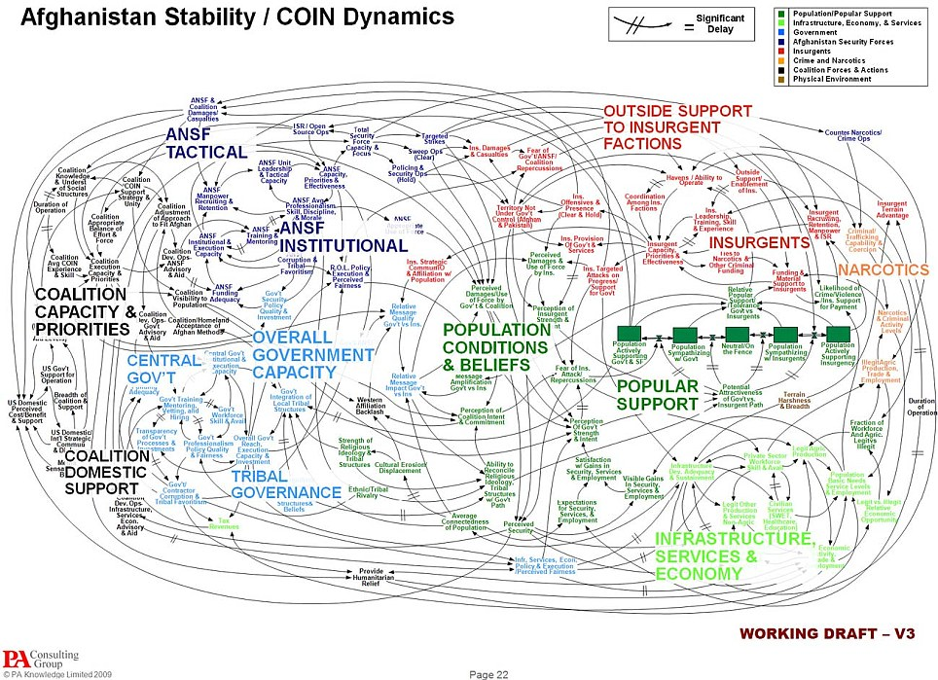

Slide 5
Organize Data Products into Files
For example:
  NOAA/NCEP/NAM/20100607/12/06/SurfacePres.nc
  NOAA/ROC/level2/KFTG/20100607/RadialVel/1345.nc
Allows subscriptions based on globbing, e.g., “NOAA/ROC/level2/**”
Problematical for numerous small data-products (e.g., WMO bulletins)?

Slide 6
Break Files into Pieces
Piece-size set by publisher
Default size about 128 kilobytes

Slide 7
BitTorrent-Like Dynamic Routing
Publisher Node
with file-pieces
A1, A2
Subscriber
Node
Subscriber
Node
Subscriber
Node

Slide 8
Advantages & Disadvantages
Advantages
  Very robust in the face of network congestion and node outages
  Automatic load balancing on the node connections
Disadvantages
  Tripling of latency (from 50 ms to 150 ms, for example) on each node-to-node connection
  Notification overhead (mitigated if notice-size << file size)

Slide 9
High Throughput Despite Additional Latency due to Multiple Asynchronous Connections
Have A6
Have A5
Node
Node
Send A3
Send A4
A2
A1

Slide 10
Dropbox Like Simplicity
Subscriber-nodes are notified when a file (i.e., product) on the publisher-node is
  Created
  Removed
All a publisher has to do is add and remove files from a file-tree

Slide 11
Tracker
Run by the publisher
Contacted by a subscriber-node to discover other nodes
Keeps track of subscriber-nodes and their subscriptions
Similar to BitTorrent (except for subscriptions rather than single files)
Single point of failure (duh!)

Slide 12
Technology Details
Java 7 (need java.nio.file for watching file-trees)
Highly multi-threaded

Slide 13
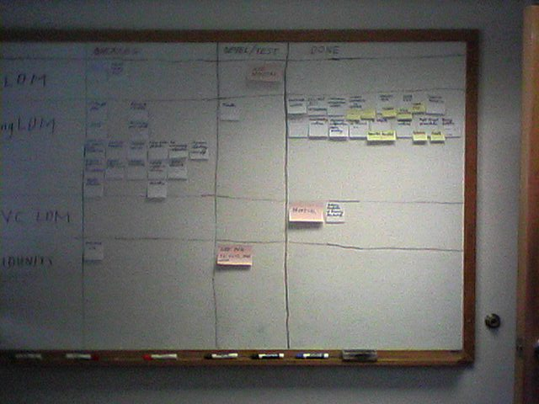
When Done?

